Slide 1
IST 687 PROJECT
Wing Measurement Data
Team Members:
Darrell Nelson
Trevor Witta
Roland Hoffman
Justin Pate

Slide 2
Project Background and scope
Currently, aerospace structures supplier “We Make Wings” supplies the wings for a jet. “Final Product Builder” is the customer. Final Product builder has given some very aggressive tolerances for the scope and large size of the structure. Base on approximately 20 units, enough data has been collected on the build process to evaluate. The company has now enlisted a team of Graduate students from Syracuse to identify opportunities in the data.
Which of the features are related via statistical correlation?
Can a valid model be created based on the data?
Is the build process improving or degrading over time?
What processes are we good at?
What processes are we bad at?
Are there any obvious outliers in the data?
Conclusions on Slide ##

Slide 3
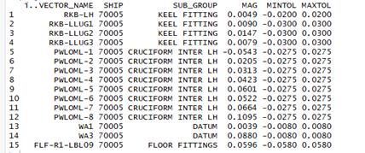
GETTING TO KNOW THE DATA
The primary fields of interest are: Ship, SUB_GROUP, Magnitude and the Tolerances to product a yield analysis.

Slide 4
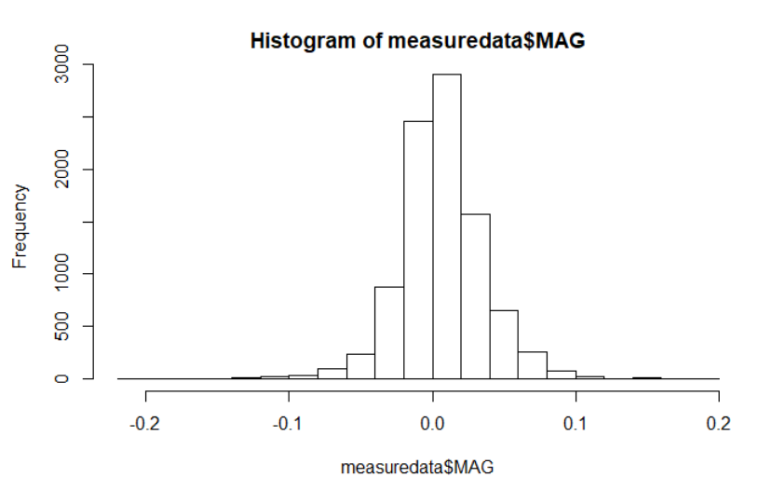
GETTING TO KNOW THE DATA
Does Over-all Mag Distribution Show us anything?
hist(subsetofmeasure$MAG)
The data distribution in the histogram shows all feature distributions. Since the perfect point would have a magnitude of 0, the highest distribution being near 0 makes sense but does not really give us any answers yet.

Slide 5
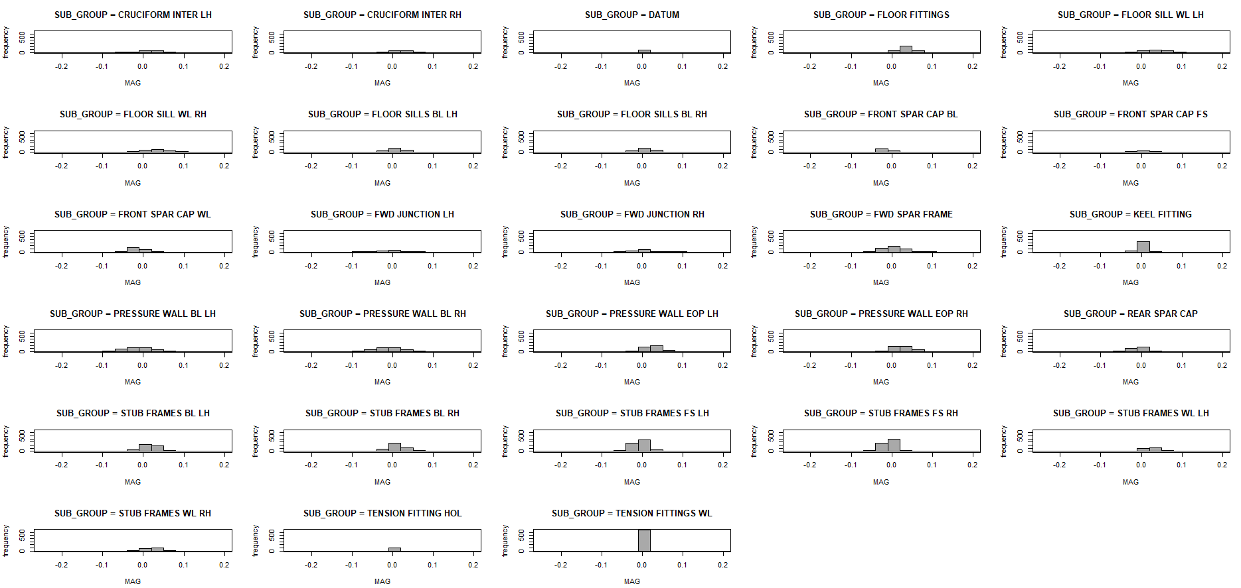
GETTING TO KNOW THE DATA
What do the distributions look like Separately
ggplot(gather(measuredata),aes(value)) + geom_histogram(bins=10)+ facet_wrap(~key, scales = 'free_x')
This might lead us down the right road!
Lets identify the features that are not centered around 0.

Slide 6
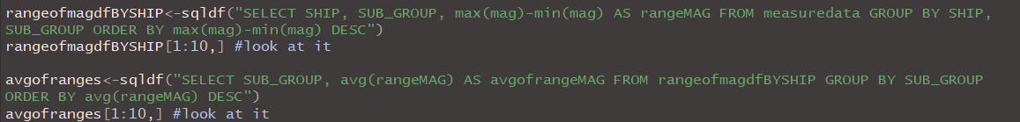
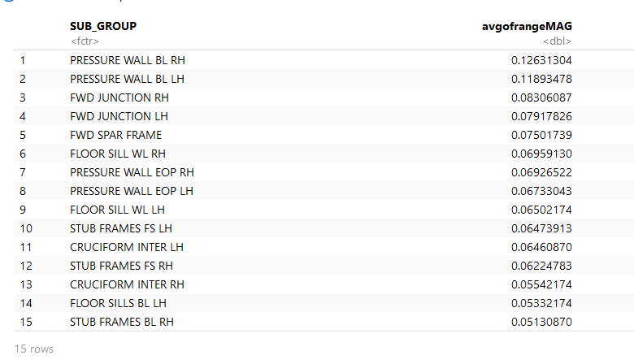
Range Analysis
Getting to know the data
GETTING TO KNOW THE DATA
Below is the top 15 features with highest ranges averaged by shipset. Let’s use some machine learning models to find correlation between any features. ***Notice most features were identified in the non-0 histogram analysis.

Slide 7
Which of the features are related via statistical correlation?

Slide 8
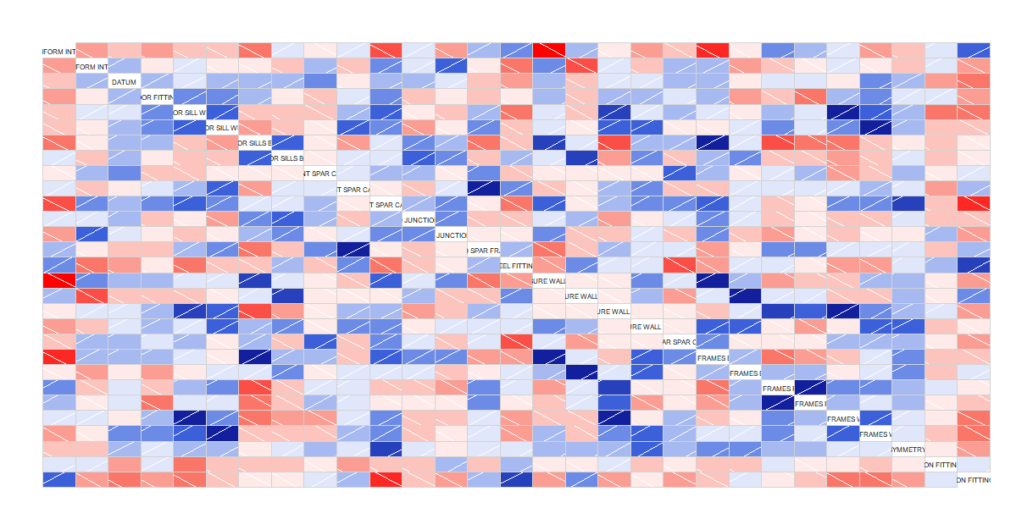
Correlated Subgroups (Heatmap)
Some subgroups are statistically correlated. Knowing which ones affect the other’s displacement and in which direction (i.e. closer or further from 0)
Dark red = strong negative correlation
Dark blue = strong positive correlation

Slide 9
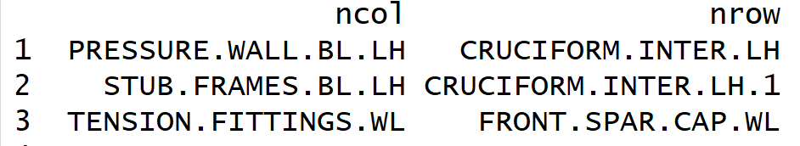
Positively Correlated Subgroups
The positively correlated subgroups have a r > 0.7
*the correlated groups are read by row
As PRESSURE.WALL.BL.LH increases in magnitude; CRUCIFORM.INTER.LH increases
As PRESSURE.WALL.BL.LH decreases in magnitude; CRUCIFORM.INTER.LH decreases

Slide 10
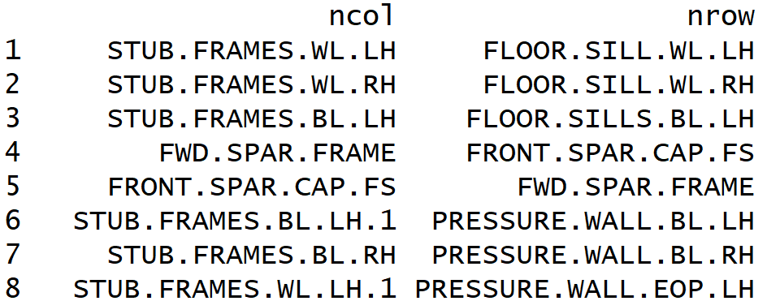
Negatively Correlated Subgroups
The negative correlated subgroups have a r < -0.7
*the correlated groups are read by row
It appears that the STUB.FRAME subgroups have a pretty strong negative correlation with FLOOR.SILL & PRESSURE.WALL subgroups.

Slide 11
2. Can a valid model be built based on the data?

Slide 12
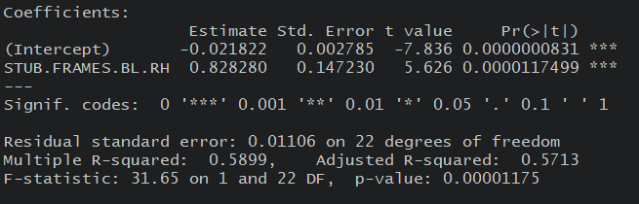
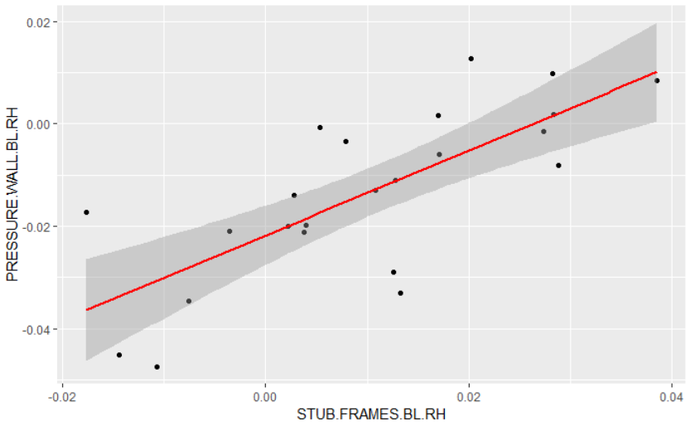
Compare features and possible model accuracy
Stub frame BL to pressure wall BL is statistically significant, however would not create an accurate model for predicting Pressure wall BL based on the adjusted R2.
This linear
model has low
confidence

Slide 13
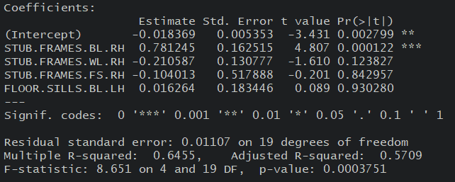
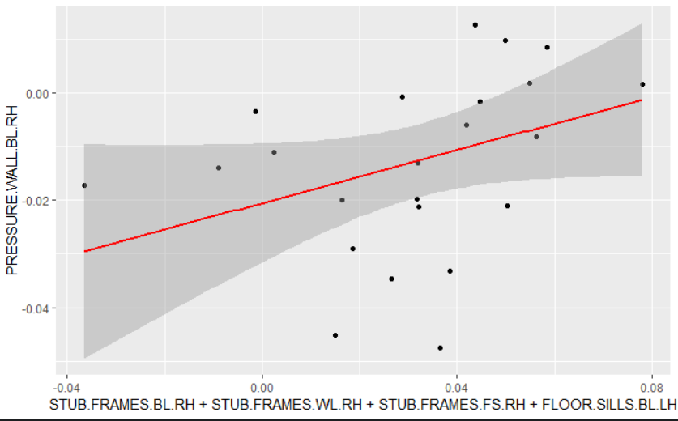
Compare features and possible model accuracy
Adding additional variables improves R2 slightly. See new regression analysis above. This however still only shows that the Stub Frame BL is significant based on probability. Next step is to remove some outliers.
This linear
model has low
confidence

Slide 14
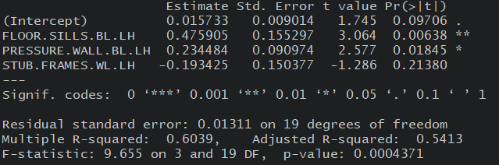
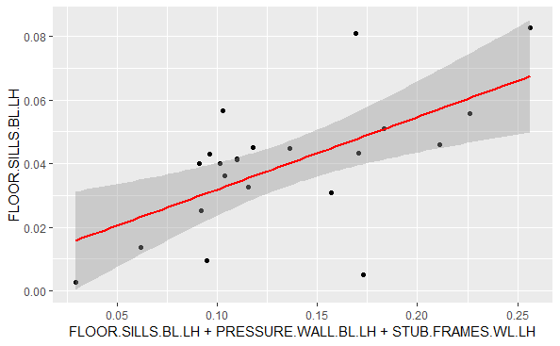
Compare features and possible model accuracy
Adding additional variables improves R2 slightly. See new regression analysis above. This however still only shows that the Stub Frame BL is significant based on probability. Next step is to remove some outliers.
This linear
Model shows signification variables, but still has low confidence due to R2.

Slide 15
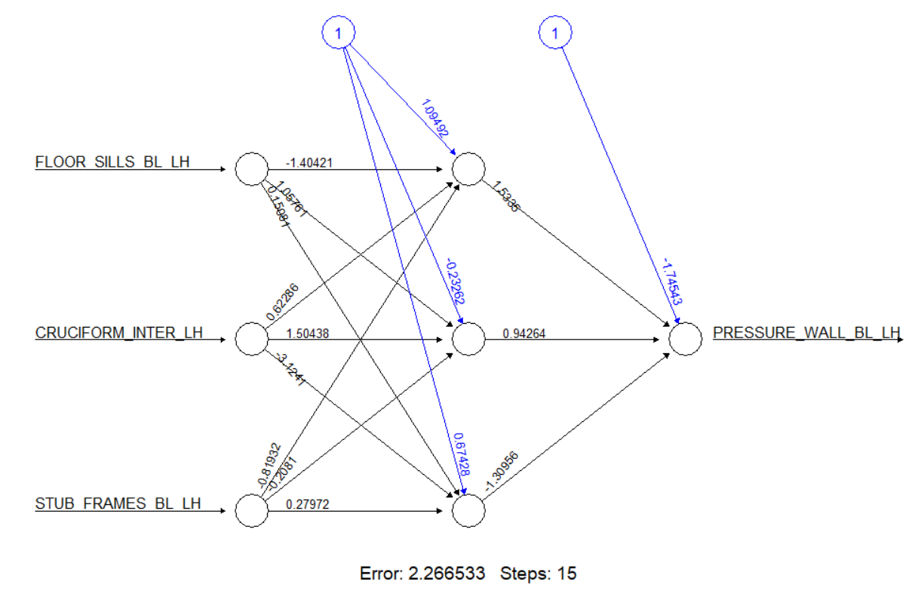
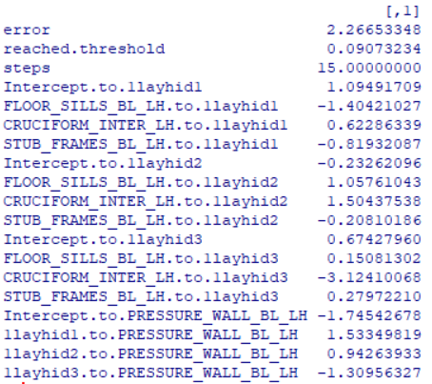
NEURAL NET AND MATRIX BELOW

Slide 16
3. Is the build process improving or degrading over time?

Slide 17
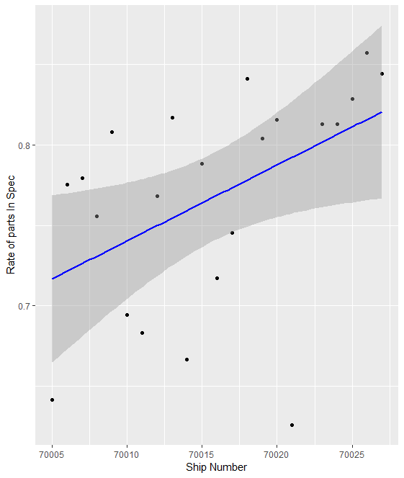
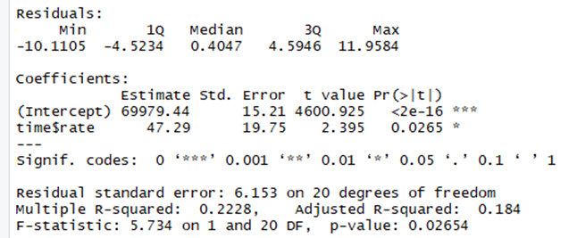
Time versus Rate of In-Spec Parts
Though there is a positive correlation between time and rate of in-spec parts, it is not a strong correlation.

Slide 18
4. What processes are we good at?
5. What processes are we bad at?

Slide 19
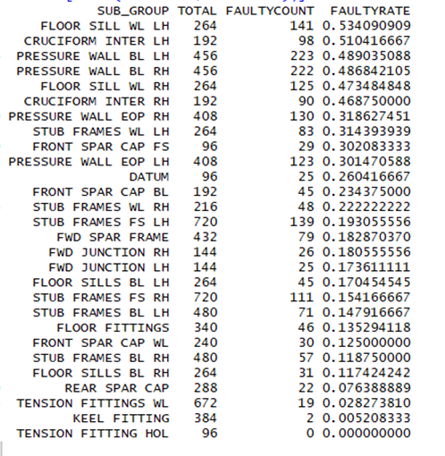
Rate of Faulty Parts by Subgroup
Using the findings to the right, we will be able to drive the manufacturing engineers to focus on improving the build process with the highest faulty rate.
We are consistently bad at manufacturing the parts at the top of the table (the top two are faulty more often than they are in-spec), and consistently good at manufacturing the parts at the bottom of the table (the bottom two are faulty less than one percent of the time).

Slide 20
6. Are there any obvious outliers in the data?

Slide 21
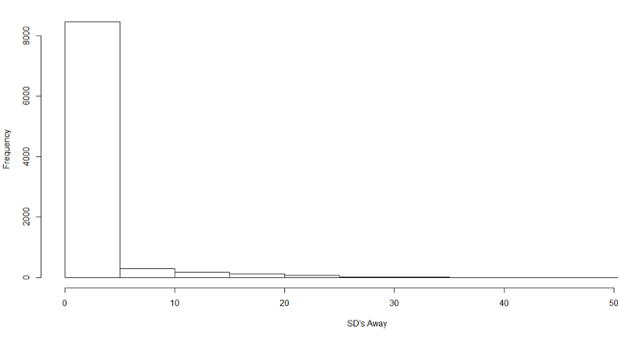
SD’s Away from the Mean
The dataset was rampant with potential outliers; 6.7% of the data was more than 6 standard deviations away from the mean of their subgroup, 4.5% was more than 10 standard deviations away, and 1.5% was an astounding 20+ standard deviations away.

Slide 22
Things I don’t know what to do with but didn’t know whether I should delete

